Slide 1
Results of Analysis
Kenny 11/06/2017

Slide 2
Notations:
T: the length of Time Epoch
R: the bouncing range of mean valuation per time epochs
N: customer number
sig: the sigma in Gaussian function. Smaller the sigma is, closer valuations are.
P: the price of smart token at the beginning of every time slot
1

Slide 3
Bancor Market:
The whole simulating time is comprised of 1000 time slots.
In every time slot, Bancor Market processes orders launched by N customers.
Valuation Making -> Transaction Launching -> Transaction Processing
2

Slide 4
Valuation Making in Bancor:
At the beginning of every time slot, N customers will be announced about the price of smart token P.
Based on this price, the market valuation of smart token per time epoch is generated as Vtp. E.g. 20 ETH. (By random pick)
By Vtp, valuation in every time slot of this time epoch can be generated as Vt. E.g. 19.2, 21.4, 20.8, 19.5 … (total number: T)
-- Vt_list = np.random.normal(Vtp, 1, T) # here 1 is the sigma
Customers according to Vt as mu in Gaussian, generate their valuations.
-- custValuation_list = np.random.normal(Vt, sig, N)
E.g. when in time slot 29, the Vt is 25.1,
customers’ valuations in this time slot are:
24.8, 23.6, 27.9, 28.4, 25.0, 25.7 …... 21.4, 25.9 (totally number: N)
3

Slide 5
Code of Random Pick:
# getrandbits(1) return False or True randomly
if bool(random.getrandbits(1)):
Vtp = random.uniform(P/R, P)
else:
Vtp = random.uniform(P, P*R)
Here we try to simulate the equal chance for market craze and market crisis.
According to the code, the valuation has 50% probability to be larger than P; while 50% probability to be smaller.
4

Slide 6
Figures about Valuation Making:
Length of Time Epoch = 200 time slots
Bouncing Range = 5.0
Length of Time Epoch = 50 time slots
Bouncing Range = 5.0
5

Slide 7
Figures about Valuation Making: (different range in y axis)
Length of Time Epoch = 200 time slots
Bouncing Range = 5.0
Length of Time Epoch = 200 time slots
Bouncing Range = 2.0
6

Slide 8
Transaction Generating in Bancor:
After customers making their valuations of smart token, they will launch transaction orders with several stipulations:
1. If valuation > Psc, customers will launch transaction orders to buy the smart token; otherwise when valuation < Psc , sell orders will be generated.
2. If customers are with no reserve tokens in hand, they will not launch buy orders, though their valuations might be higher than Psc. Ditto for sell orders.
3. Customers make valuations and launch orders in every time slot; while in one time slot, one customer can only try to generate one order.
This indicates in 1000 time slots, totally <=1000N transaction orders will be made, as the customer might have no reserve token to buy or smart token to sell.
4. Customer uses all of their reserve tokens or smart tokens to buy or to sell if they have money in hand.
7

Slide 9
Code about Transaction Generation:
# self represents a customer (customer class). we name him/her as XXX
if self._valuation > marketPrice and self._reserveBalance > 0:
# XXX issues a buy order
self._market.buy(self, self._reserveBalance) # all-in policy
elif self._valuation < marketPrice and self._tokenBalance> 0:
# XXX issue a sell order
self._market.sell(self, self._tokenBalance)
else:
# nothing to do
pass
After customers generating their transaction orders by valuations and money they hold, they wait to see whether market could match their orders.
8

Slide 10
Transaction Processing in Bancor:
Bancor Market processes customers' transaction orders one by one.
In customers’ eyes:
Customers generate valuations of product first, and then accord to the product‘s real-time price in market to decide whether to cancel the transaction.
In market’s eyes:
When dealing with one of customers‘ transaction orders, market always waits for customers’ responses. If the real-time price of smart token does not meet one customer‘s valuation, the market will be announced that this customer has canceled this order. Then, the market skips this transaction order to try to deal with the next customer’s order.
9

Slide 11
Price fluctuation in Bancor: (now meets our expectation)
Y-axis: Price of smart token (ETH)
X-axis: time of the simulation
The price change in Bancor Market
when T = 50, R = 2.0, N=1000, sig=2.0.
10

Slide 12
Cancellation Rate in Bancor Market:
Further, since transaction orders might be canceled in market, we also track the cancellation rate of transaction orders successfully launched by customers.
11

Slide 13
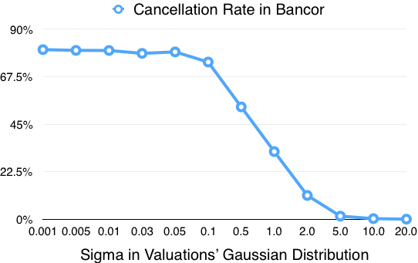
Bancor Cancellation Rate when sigma changes:
T = 50,
R = 2.0,
N=1000,
sig changes
12

Slide 14
Bancor Cancellation Rate when sigma changes:
With smaller sigma, the transactions’ cancellation rate is much higher [explained in annex], which indicates more tightly customers make their valuations, more likely they need to cancel their transaction orders.
To view mathematical proof, see slides from annex 1 to annex 9.
13

Slide 15
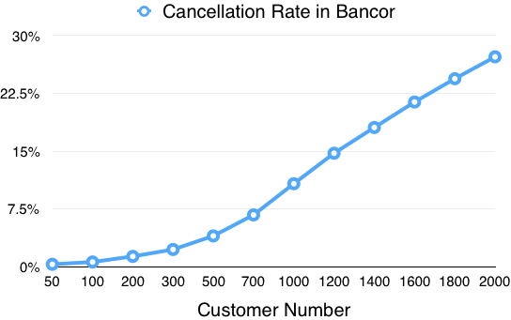
Bancor Cancellation Rate when Customers’ Number changes:
T = 50,
R = 2.0,
N changes
sig = 2.0
14

Slide 16
Bancor Cancellation Rate when Customers’ Number changes:
With larger customer number, the transactions’ cancellation rate is much higher.
The reason is that we set every customer initially has 200 reserve tokens and 200 smart tokens.
Assuming customers all buy smart tokens:
In 50 customers’ market, 200*50 reserve tokens are converted to smart tokens.
In 2000 customers’ market, 200*2000 reserve tokens are converted to smart tokens.
Therefore, the price of smart token fluctuates more fiercely in 2000 customers’ market.
15

Slide 17
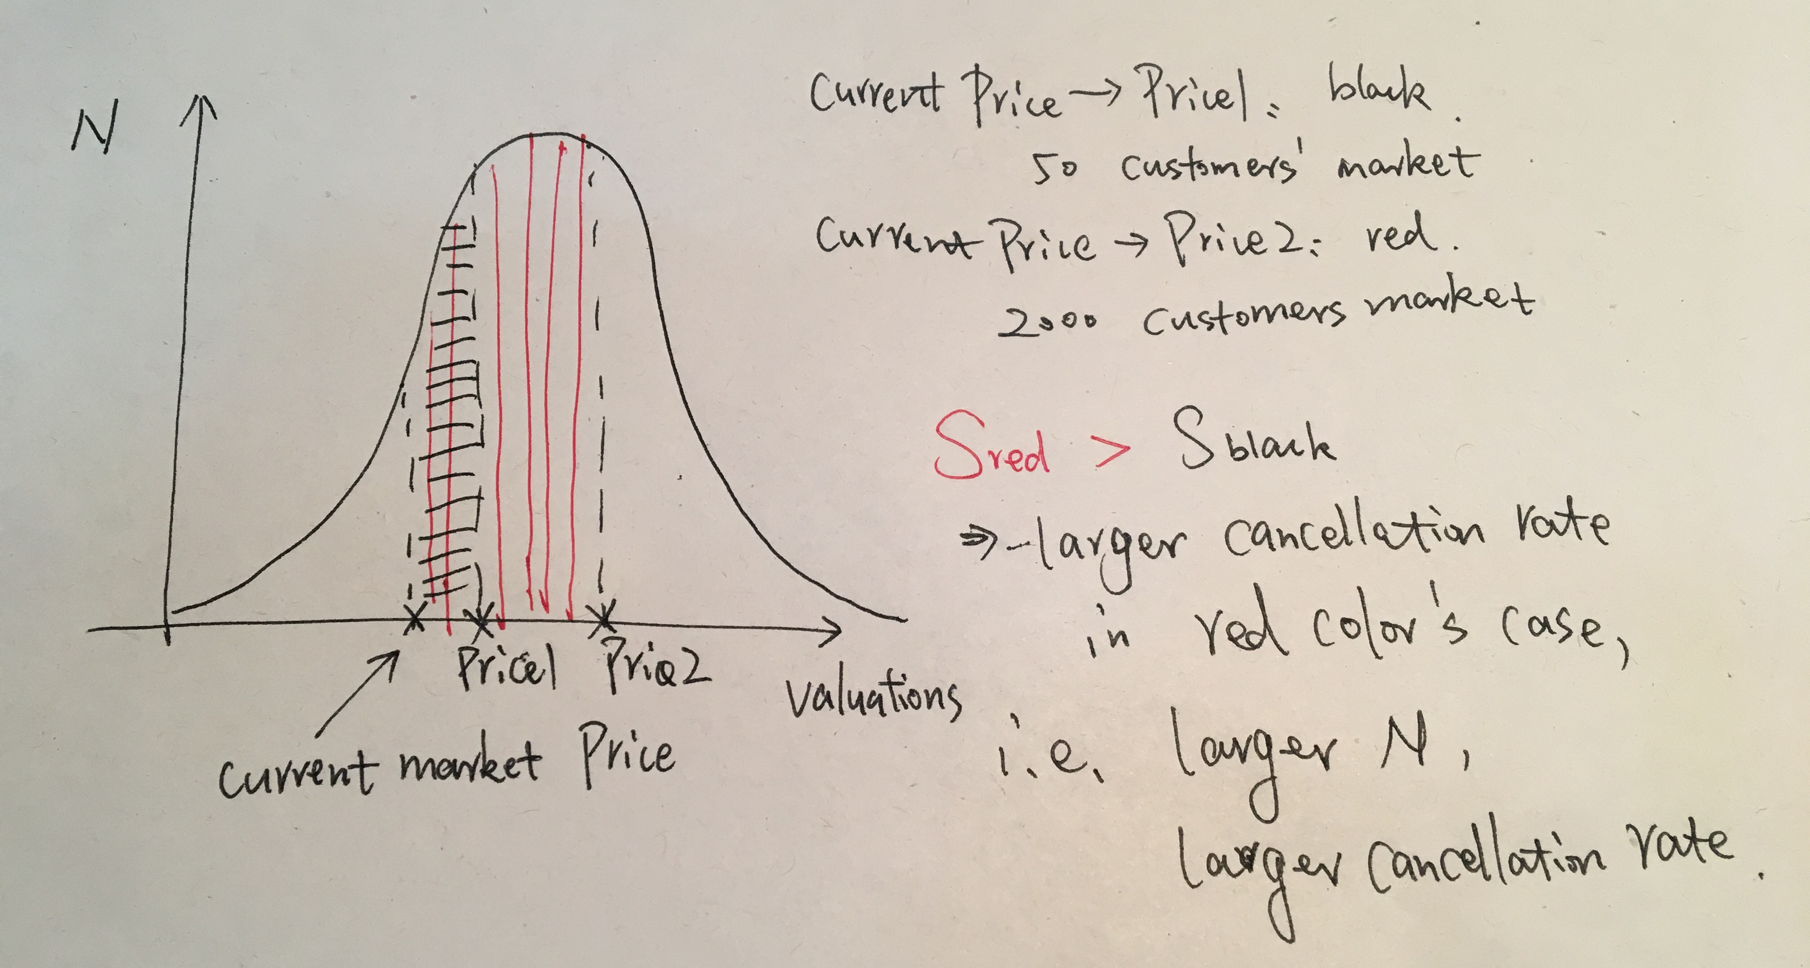
Bancor Cancellation Rate when Customers’ Number changes:
16

Slide 18
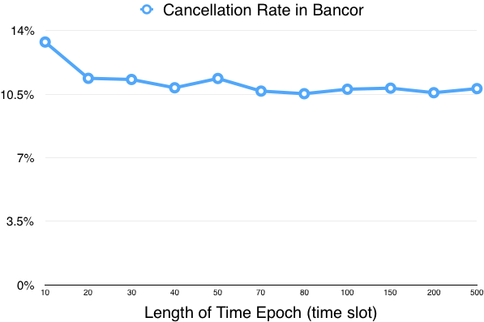
Bancor Cancellation Rate when Length of Time Epoch changes:
T changes,
R = 2.0,
N = 1000
sig = 2.0
17

Slide 19
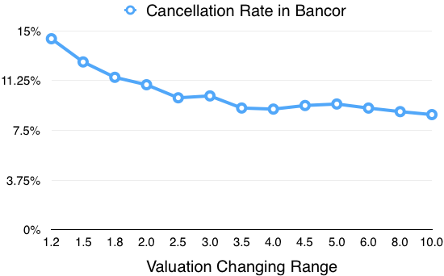
Bancor Cancellation Rate when Bouncing Range changes:
T = 50,
R changes,
N = 1000
sig = 2.0
18

Slide 20
Classic Market:
The whole simulating time is comprised of 1000 time slots.
In every time slot, Classic Market processes the orders launched by N customers by managing the order list in the market.
Valuation Making -> Transaction Launching -> Transaction Processing
19

Slide 21
Valuation Making in Classic:
The valuation making in Classic Market is similar with Bancor Market.
However, since smart tokens in classic market are not created or destroyed, the price of the smart token is a constant.
20

Slide 22
Transaction Generating in Classic:
1~4 stipulations are similar with Bancor Market.
5. A customer will not launch new order if his order has not been fulfilled.
For instance, in a certain time slot, a customer launches a sell order at valuation 5 ETH to sell all of his 200 smart tokens.
However, in the next time slot, he finds that only 120 smart tokens have been sold. Therefore, he will not launch new order and continue to wait for his remained 80 smart tokens being sold at valuation 5 ETH.
In the end of simulation, i.e., 1000 time slots have passed, if this transaction order is still unfinished in market, we say this order should be canceled.
21

Slide 23
Transaction Processing in Classic:
Classic Market manages an order list to process all transaction orders launched by customers.
In short, all transaction orders from customers will be separated into two sub-lists, named as sell list and buy list. In each list, orders will be sorted by the valuation of these orders.
22

Slide 24
Transaction Processing in Classic:
23
Notes:
Blue plus red cancel
Red fail

Slide 25
Transaction Processing in Classic:
Both Partially Failed orders and Totally Failed orders will be remained in order list and expect in the next time slot they can be finished.
However, if these orders are never finished -- after 1000 time slot, they still are in the market, we then say these orders should be canceled.
Thus, we calculate the cancellation rate by:
# of orders remained in market / # of all launched orders.
24

Slide 26
Comparison Between Bancor and Classic's Cancellation Rate :
The review of Cancellation Rate:
In Bancor:
Why: The price of smart token cannot meet customer's valuation in order.
Cal: cancellation rate = # of all canceled orders / # of all launched orders
In Classic:
Why: Customer's order cannot be finished before the end of simulation.
Cal: cancellation rate = # of all unfinished orders / # of all launched orders.
25

Slide 27
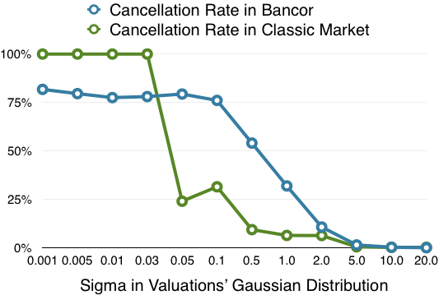
Comparison between Bancor and Classic when sig changes:
T = 50,
R = 2.0,
N=1000,
sig changes
26

Slide 28
Comparison between Bancor and Classic when sig changes (log):
T = 50,
R = 2.0,
N=1000,
sig changes
27

Slide 29
Comparison between Bancor and Classic when sig changes:
The reason for 100% cancellation rate is:
under small sigma such as 0.001, 0.005 and so on, every customer almost makes the same valuation.
For instance, every one makes a valuation at 20 ETH when the price of smart token is 15 ETH.
Due to our simulating rules – “larger to buy, smaller to sell”, every customer wants to buy smart tokens.
Then, all customers are stuck in market as no matched orders in market will release their launched orders.
In this case, the problem of “Co-incidence of Double wants” does exist.
However, when sigma is large, 10 for instance.
When the price of smart token is 15 ETH, customers’ valuations can be 5 ETH, 18 ETH, 29 ETH and etc.
In this case, there are always buyers and sellers in the market.
Therefore, the cancellation rate in classic market is low.
28

Slide 30
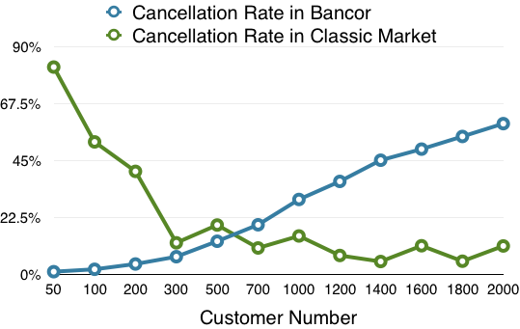
Comparison between Bancor and Classic when N changes:
T = 50,
R = 2.0,
N changes
sig = 1.0
29
Notes:
For instance, there are only 2 customers in the classic market.
If the current price of smart token is 20 ETH and they based on mean valuation 20 ETH to generate valuations, the probability they both generate buy order is 0.5^2.
Similarly, the probability they both generate sell order is 0.5^2.
Therefore, the probability of the situation that the market is locked is 2 * 0.5^2 = 0.5
However, when there are 200 customers in market, the probability of being locked is 2 * 0.5 ^200 << 1
That is why with higher customer number, the cancellation rate in classic market can be lower.
Actually, since customers might based on 18 ETH, 22 ETH … as mean valuation to generate valuations, therefore the probability in 2 customers’ case could be 0.9^2 + 0.1^2 =0.811 > 0.5.
That is the reason why when the customer number is small, the cancellation rate in classic market can be such high (about 80%).

Slide 31
Explanation of higher customer number, lower cancellation rate in classic market :
For instance, there are only 2 customers in the classic market.
If the current price of smart token is 20 ETH and they based on mean valuation 20 ETH to generate valuations, the probability they both generate buy order is 0.5^2.
Similarly, the probability they both generate sell order is 0.5^2.
Therefore, the probability of the situation that the market is locked is 2 * 0.5^2 = 0.5
However, when there are 200 customers in market, the probability of being locked is 2 * 0.5 ^200 = 0.5 ^ 199 << 0.5
That is why with higher customer number, the cancellation rate in classic market can be lower.
Actually, since customers might based on 18 ETH, 22 ETH … as mean valuation to generate valuations, the probability in 2 customers’ case could be 0.9^2 + 0.1^2 =0.811 > 0.5.
That is the reason why when the customer number is small, the cancellation rate in classic market can be such high (about 80%).
30

Slide 32
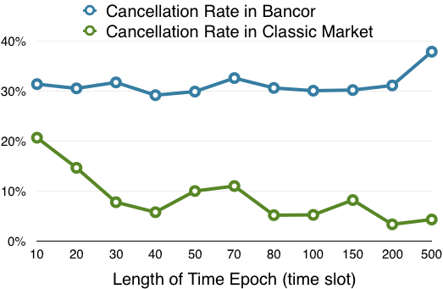
Comparison between Bancor and Classic when T changes:
T changes,
R = 2.0,
N = 1000
sig = 1.0
31

Slide 33
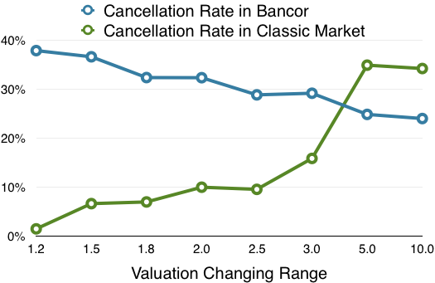
Comparison between Bancor and Classic when R changes:
T = 50,
R changes,
N = 1000
sig = 1.0
32
Notes:
With

Slide 34
Explanation of higher R, higher cancellation rate in classic market :
For instance, there are 2 customers in the classic market.
If the current price of smart token is 20 ETH and R is 1,
customers are likely based on mean valuation 20 ETH to generate valuations, the probability of the situation that the market is locked is 2*0.5^2 = 0.5
However, when R is high, customers are likely based on mean valuation 16 ETH, 24 ETH, … to generate their valuations, the probability of being locked might be a^2 +(1-a)^2, a != 0.5 and 0 < a < 1.
In mathematic, 0.5 < a^2 +(1-a)^2.
Therefore, with higher R, higher the cancellation rate in classic market is.
33

Slide 35
Summary:
Silde 11: The market craze or market crisis can lead to price of smart token bouncing fiercely between different time epochs.
Silde 13 & 14: the order’s cancel rate in Bancor Market can be quite high -- reaching beyond 20% in several parameter settings, especially when customers’ valuations are made tightly, i.e., sigma is small, and customers’ number is large.
Slide 26: The low classic cancellation rate in Figure indicates the “co-incidence of double wants” might not be a problem in Classic Market when customers’ valuations vary.
Slide 26 -- 31: The cancellation rate in Bancor Market in many cases is much higher than in Classic Market.
34

Slide 36
Summary:
Recently, I have cleaned my code and added many comments. They are presented on:
https://github.com/Ohyoukillkenny/Bancor-Simulator
35

Slide 37
Proof of smaller sigma, higher cancel rate:
The Gaussian function in different sigma settings. Smaller the sigma is, steeper the Gaussian curve is.
Annex 1

Slide 38
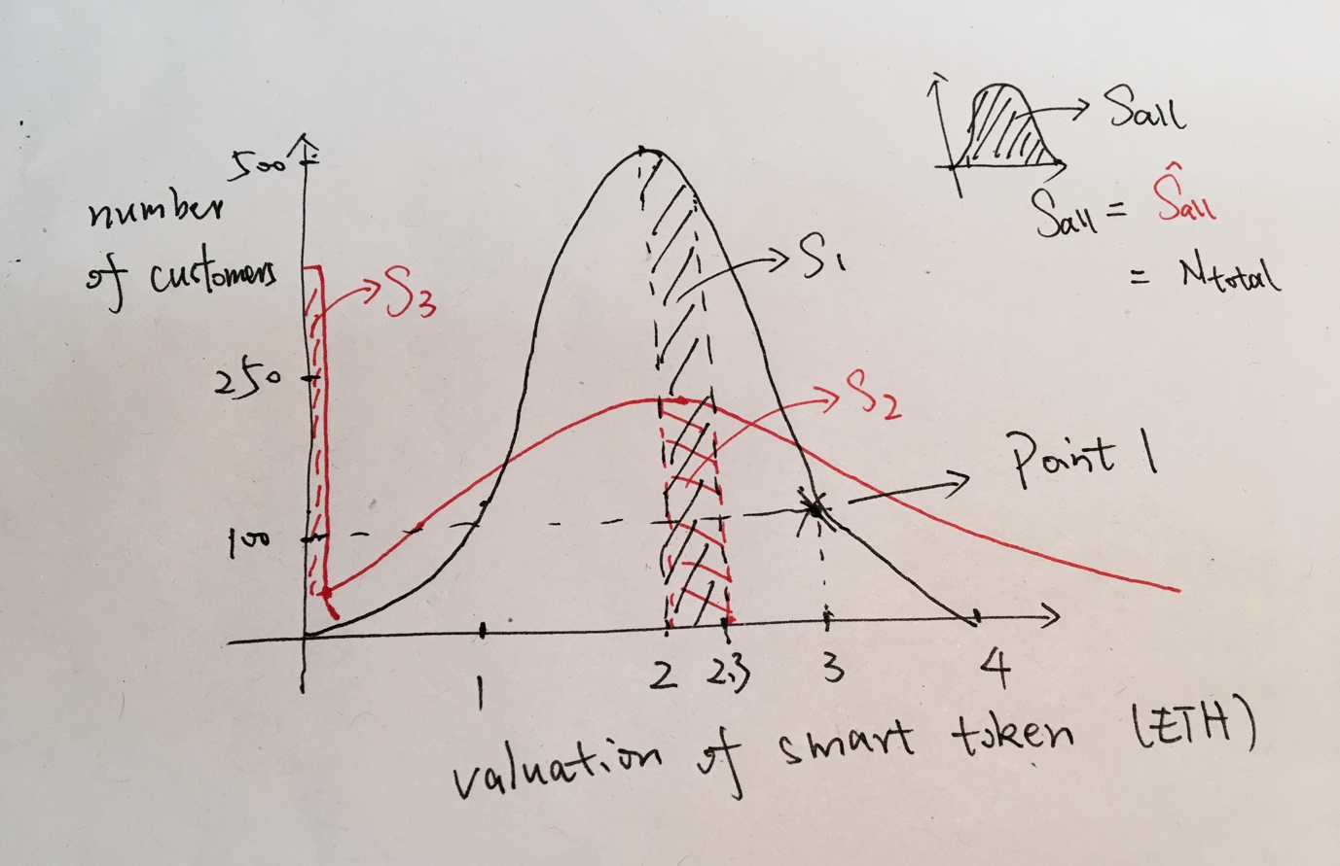
Proof of smaller sigma, higher cancel rate:
The black curve shows the valuation distribution with sig1, the red curve shows with sig2. By the previous slide, we know sig2 > sig1. The mean valuation is 2.
Annex 2

Slide 39
The point 1 means there are 100 customers making valuation as 3 ETH.
Thus, by doing a simple calculus, like small plot in the right-top corner of Figure, we know that the total area rounded up by x-axis and Gaussian curve is the total number of customers.
Annex 3

Slide 40
Since both in red curve and black curve, there are totally 2000 customers coming into market,
we know that:
S all = S all = N total
= 2000 (# of customers)
Annex 4

Slide 41
When one customer successfully making his transaction, the price of smart token in market will fluctuate, from 2 ETH to 2.3 ETH.
Annex 5

Slide 42
In this case, the blacked shadowed area S1 or the red shadowed area S2 presents the number of customers who now cannot make transactions.
(buy-order valuation smaller than current price of smart token)
Annex 6

Slide 43
Hence, the current probability of customers‘ order being canceled in black-curve distribution:
Pr = S1/S all = S1/N total.
Similarly,
Pr = S2/S all = S2/ N total.
Apparently, S1 > S2. Therefore, in current state, Pr > Pr.
Annex 7

Slide 44
Proof of smaller sigma, higher cancel rate:
In fact, whether the price of smart token is increasing or decreasing, Pr is always larger than Pr. This indicates, at every time, the probability of transaction being canceled in Black curve Gaussian distribution (with sig1) is larger than it in red curve (with sig2).
Combining with the fact that sig2 > sig1, the proof of smaller sigma causing higher cancel rate is done.
Annex 8

Slide 45
Proof of smaller sigma, higher cancel rate:
If you are careful enough, you might notice the weird S3 area.
This is because when the valuation by Gaussian function is smaller than 0, we set this valuation to be 0.001 * mean valuation (in our example is 0.002). Therefore, S3 actually equals with number of customers who generate valuation smaller than 0.
for i in range(custNum):
if custValuation_list[i] < 0:
# Customer does not want to sell their token in free.
# Here we give them a small valuation when valuation < 0
custList[i].changeValuation(0.001*currentMarketPrice)
else:
custList[i].changeValuation(custValuation_list[i])
Actually, S3 does not disturb the proof at all, since larger the S3 is, smaller the S2 is.
Annex 9

